Slide 1
AI Marketplace
Empowering Artisan Commerce with AI

Slide 2
Introduction
Our AI-powered marketplace aims to bridge the digital divide for over 200 million artisans in India.
It combines multilingual support, easy product listing, and engaging storytelling to help artisans reach global customers while preserving cultural heritage.
The platform represents more than a business solution—it's a commitment to cultural preservation, economic empowerment, and the belief that technology should serve to amplify human creativity rather than replace it. As we build this marketplace, we're creating pathways for artisans to share their stories, showcase their craftsmanship, and build direct relationships with customers who value authenticity and cultural richness.

Slide 3
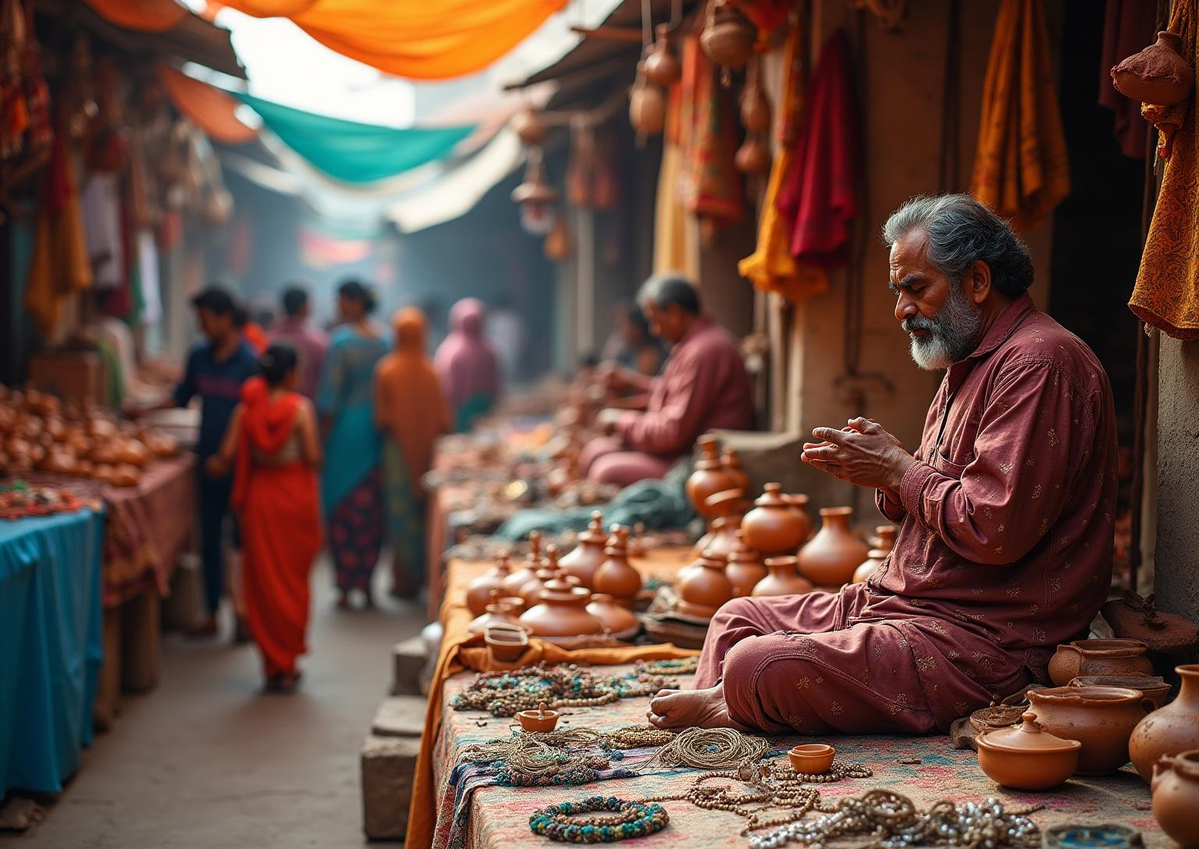

01
AI Marketplace Vision and Market Opportunity

Slide 4
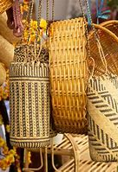
Vision and Mission of the AI-Powered Artisan Marketplace
Our Vision is to bridge the digital divide for Indian artisans, preserving heritage while enabling global reach.
The Mission is to create an inclusive, multilingual AI assistant that helps artisans create, market, and sell products digitally, ensuring no craftsperson is left behind.
This empowers artisans economically and culturally.

Slide 5
Market Challenges and Opportunities for Indian Artisans
Many artisans face a digital literacy gap and language barriers, limiting their market reach and pricing power.
With 85% lacking digital skills, most sell within 50 km radius and struggle with documentation.
The fast-growing $44B+ handicraft market presents huge opportunities for connected artisans.
AI can help overcome these barriers and open national and global markets.
International buyers increasingly value cultural storytelling and ethical sourcing. E-commerce democratization, mobile internet penetration, and digital payment systems are rapidly expanding accessibility.
Government initiatives like Digital India and growing appreciation for "vocal for local" movements create favorable conditions. The post-pandemic shift toward meaningful consumption and cultural authenticity positions Indian artisans perfectly to capture global market share through technology-enabled platforms.

Slide 6
Economic and Social Impact Projections
For artisans, we expect 300-500% income growth, expanding markets from local to global.
Buyers gain authentic craft access with fair pricing and cultural education.
Socially, the platform preserves 1000+ traditions digitally and improves digital literacy for over 100,000 artisans.
This bridges the rural-urban digital divide while empowering marginalized groups, especially women.
Socially, the platform promises profound cultural preservation impact. By making traditional crafts economically viable, we project a 40% reduction in craft abandonment rates among younger generations. Women artisans, comprising 60% of India's craft workforce, stand to benefit disproportionately through increased financial independence and social mobility.
The platform's storytelling features will document and preserve over 1,000 traditional techniques, creating an invaluable digital heritage archive while connecting global consumers to authentic cultural narratives.

Slide 7
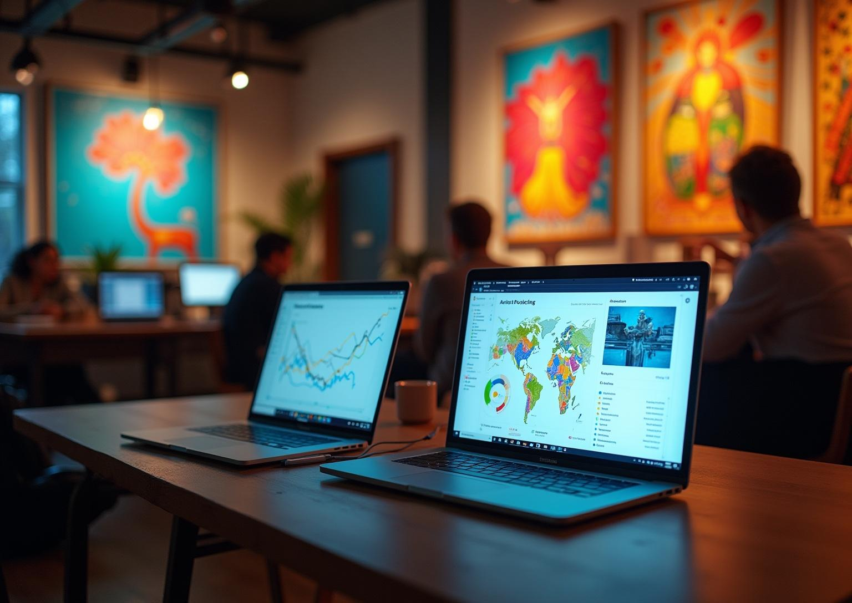

02
Core Features and
Technical Architecture

Slide 8
Intelligent Product Listing Generator with Multimodal Inputs
Transforms artisan photos and voice notes into professional listings effortlessly.
Supports 22 Indian languages and auto-categorizes into 500+ crafts with SEO optimization.
The generator automatically creates SEO-optimized titles, detailed descriptions highlighting unique selling points, appropriate category tags, and suggested pricing based on similar products and regional market analysis.
It incorporates cultural storytelling elements, explaining the heritage behind techniques, the significance of patterns, and the artisan's personal journey, creating emotional connections that justify premium pricing and build customer loyalty.
Adds cultural context via AI-generated descriptions to boost buyer engagement.
The AI translates and enhances these descriptions while preserving authentic voice and cultural nuances, ensuring listings maintain personal touch while meeting international marketing standards.

Slide 9
AI Storytelling, Recommendation System and Multilingual Voice Assistant
The storytelling engine turns artisan backgrounds into compelling brand stories with videos and photos.
Recommendation system blends behavioral and content filters for personalized craft discovery.
Multilingual voice assistant provides voice-driven onboarding, management, and support in local languages anytime.
Enables natural language interaction in 15+ Indian languages for artisans with varying digital literacy.
The section emphasizes how these technologies work synergistically to bridge the digital divide while preserving cultural authenticity. Each feature addresses specific pain points in the artisan-to-customer journey while maintaining the platform's core mission of cultural preservation and economic empowerment.
Provides personalized experiences for both buyers (product discovery) and artisans (business optimization).

Slide 10
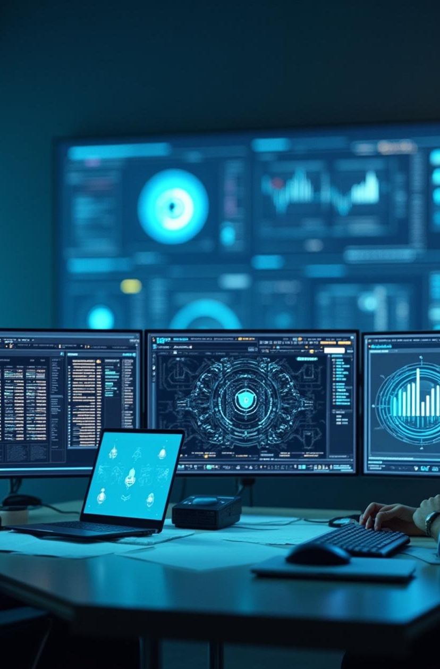
System Architecture: AI, Data Layers, Integration, and Security
Built on microservices architecture using Google Cloud AI tools like Gemini Pro and Vertex AI.
Data layers include BigQuery analytics, Firestore database, and rich multimedia storage.
Integration covers payments, logistics, and multilingual voice interfaces with strong security, encryption, and compliance.
Multi-layered enterprise security Compliance with Indian and international regulations Blockchain for authenticity verification

Slide 11
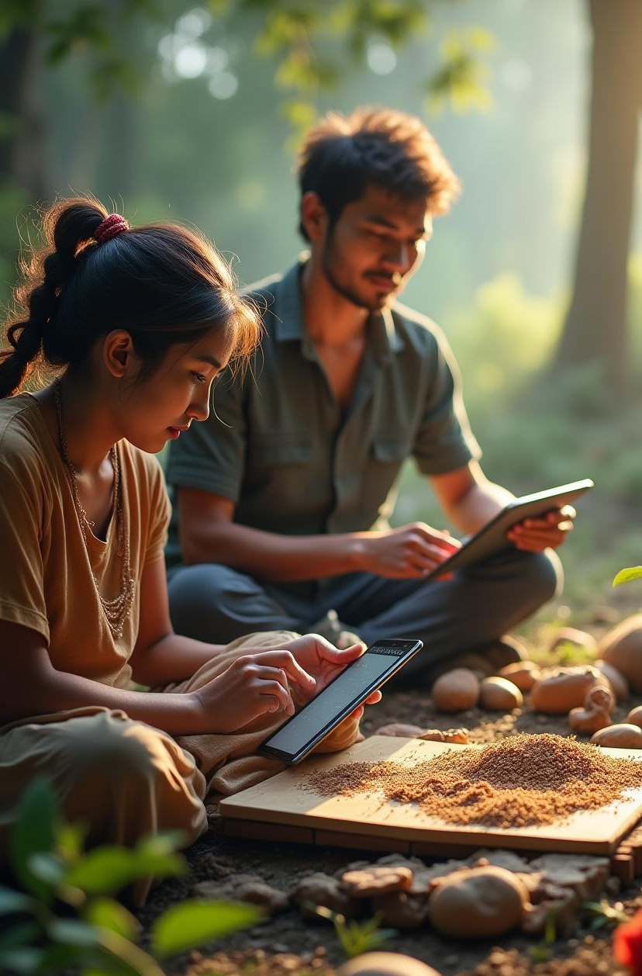
Conclusion
This AI marketplace empowers Indian artisans with digital skills, multilingual tools, and AI-driven storytelling.
It unlocks new markets while preserving cultural heritage and supporting sustainable economic growth.
By combining advanced AI with local language support, it creates an inclusive, vibrant ecosystem for artisans and buyers alike.
This platform is a promising step toward bridging the digital divide and fostering global artisan recognition.

Slide 12
Thank you!
Do you have any questions ?
The creation of this Presentation is credited to:
Sumit Kumar Saini, Vansh Oberoi, Ved Prakash Sharma & Yash Choudhary
+00 000 000 000

